Slide 2


Slide 3
“The Golden Eagles”

Slide 4
2024–’25
“The Golden Eagles”

Slide 5
2024–’25
“The Golden Eagles”
Last Take Offs

Slide 6
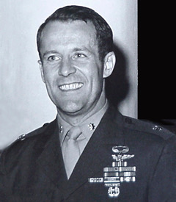

LtCol Harlan P. Chapman, USMC (Ret)
May 06, 2024
Silver Star

Slide 7
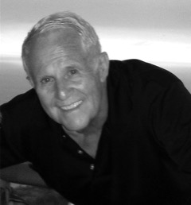
LtCol Harlan P. Chapman, USMC (Ret)
May 06, 2024

Slide 8
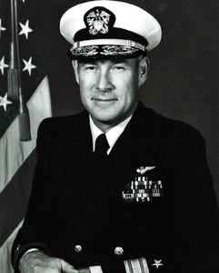
RADM Kenneth Pettigrew, USNR (Ret)
June 23, 2024
Silver Star

Slide 9
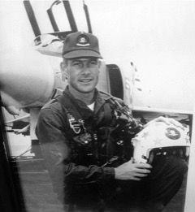
RADM Kenneth Pettigrew, USNR (Ret)
June 23, 2024

Slide 10
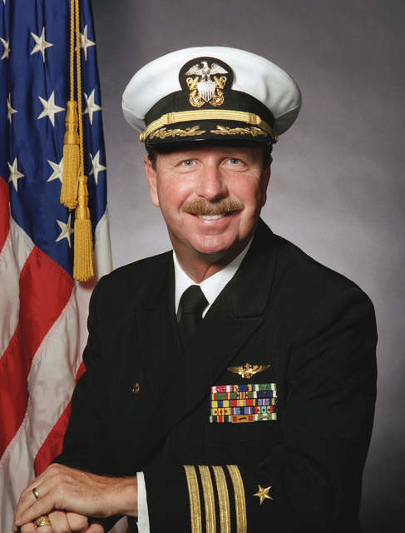
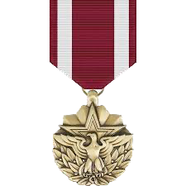
CAPT William S. “Bud” Orr, USN (Ret)
July 08, 2024
Meritorious
Service
Medal

Slide 11
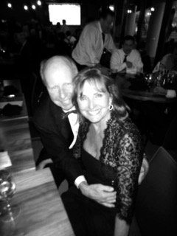
CAPT William S. “Bud” Orr, USN (Ret)
July 08, 2024

Slide 12
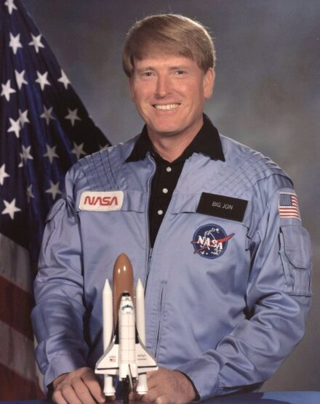

CAPT Jon A. McBride, USN (Ret)
August 07, 2024
Legion
of
Merit

Slide 13
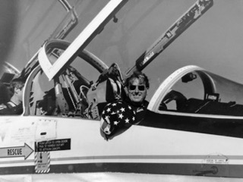
CAPT Jon A. McBride, USN (Ret)
August 07, 2024

Slide 14
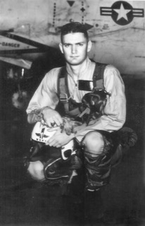

CDR John C. “JC” Davis II, USN (Ret)
August 31, 2024
Distinguished
Flying
Cross
(3)

Slide 15
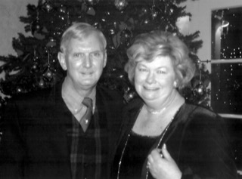
CDR John C. “JC” Davis II, USN (Ret)
August 31, 2024

Slide 16
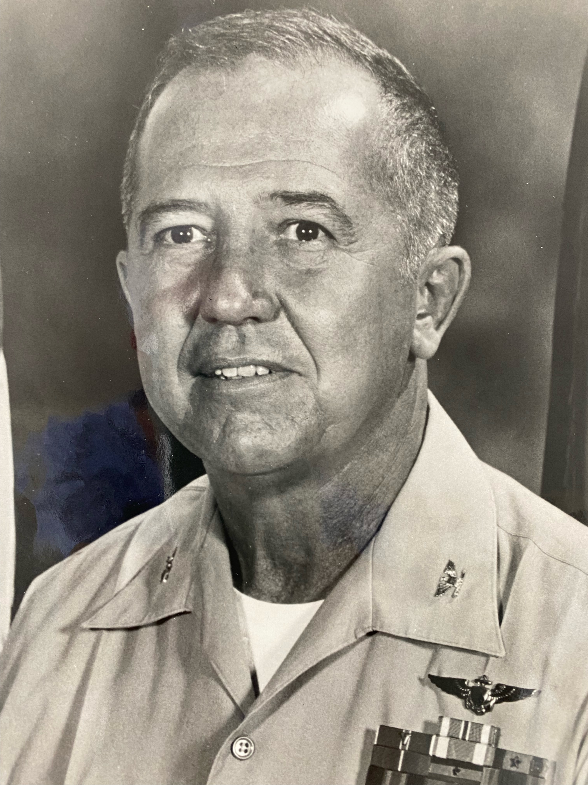
Col Melvin H. Sautter, USMC (Ret)
September 06, 2024
Legion
of
Merit

Slide 17
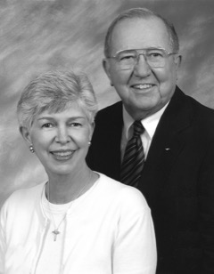
Col Melvin H. Sautter, USMC (Ret)
September 06, 2024

Slide 18
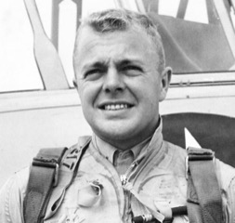

RADM Thomas C. Watson Jr., USN (Ret)
November 01, 2024
Distinguished
Flying
Cross
(2)

Slide 19
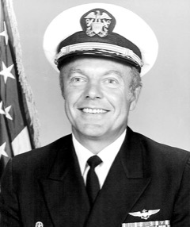
RADM Thomas C. Watson Jr., USN (Ret)
November 01, 2024

Slide 20
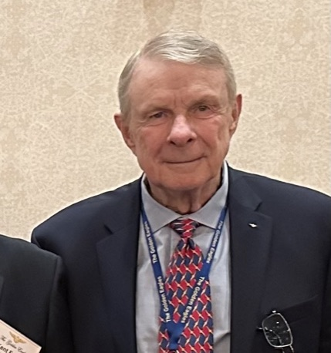
CDR J. Richard Brown, USN (Ret)
January 15, 2025
Meritorious
Service
Medal

Slide 21
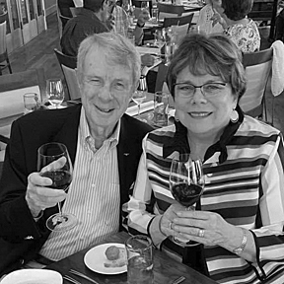
CDR J. Richard Brown, USN (Ret)
January 15, 2025

Slide 22
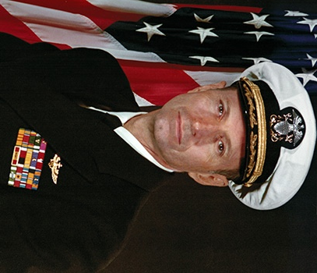
CAPT Fred A.W. Franke, USN (Ret)
February 17, 2025
Legion
of
Merit

Slide 23
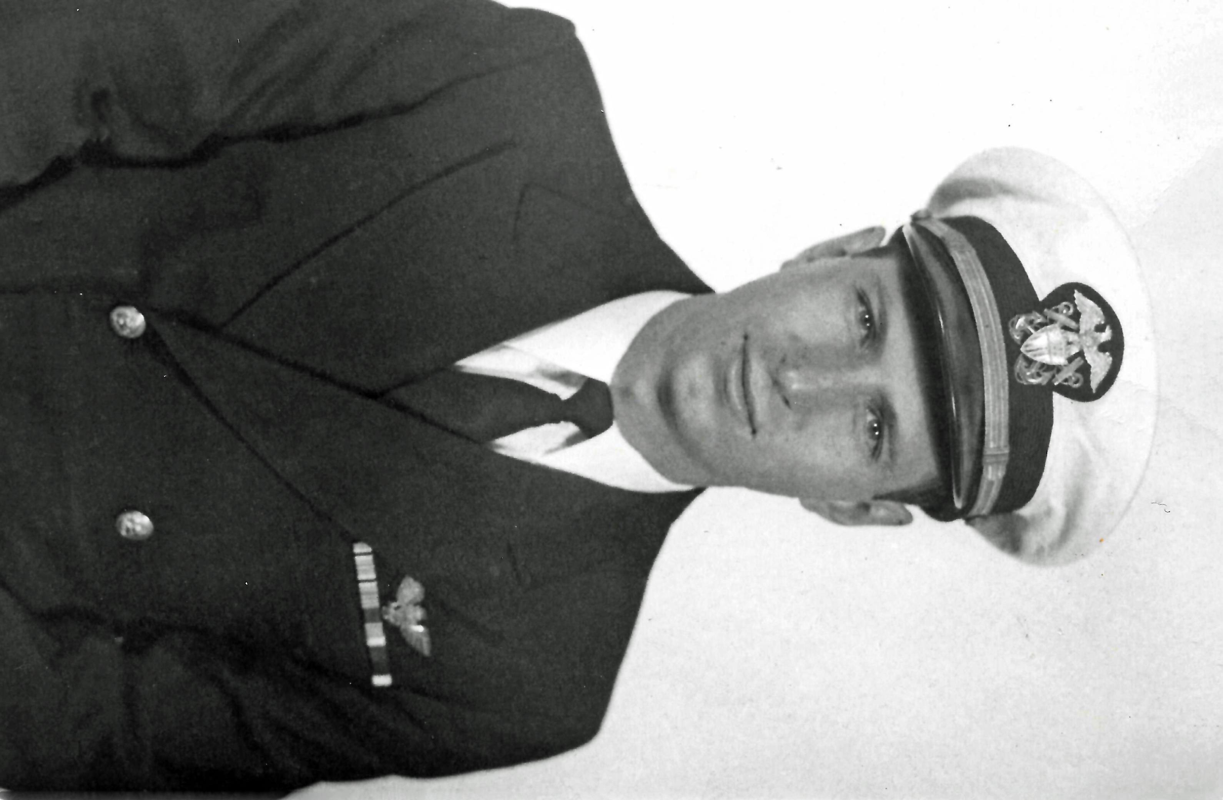
CAPT Fred A.W. Franke, USN (Ret)
February 17, 2025

Slide 25

Golden Eagle Spouses/Widows
Lynn Watson April 20, 2024
Jetta Lenox August 20, 2024

Slide 26

God bless them all … each one an American original

Slide 27
Eulogies

Slide 28
LtCol Harlan P. Chapman, USMC (Ret)
May 06, 2024

Slide 29
RADM Kenneth Pettigrew, USNR (Ret)
June 23, 2024

Slide 30
CAPT William S. “Bud” Orr, USN (Ret)
July 08, 2024

Slide 31
CAPT Jon A. McBride, USN (Ret)
August 07, 2024

Slide 32
CDR John C. “JC” Davis II, USN (Ret)
August 31, 2024

Slide 33
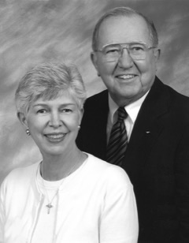
Col Melvin H. Sautter, USMC (Ret)
September 06, 2024

Slide 34
RADM Thomas C. Watson Jr., USN (Ret)
November 01, 2024

Slide 35
CDR J. Richard Brown, USN (Ret)
January 15, 2025

Slide 36
CAPT Fred A.W. Franke, USN (Ret)
February 17, 2025

